Slide 1
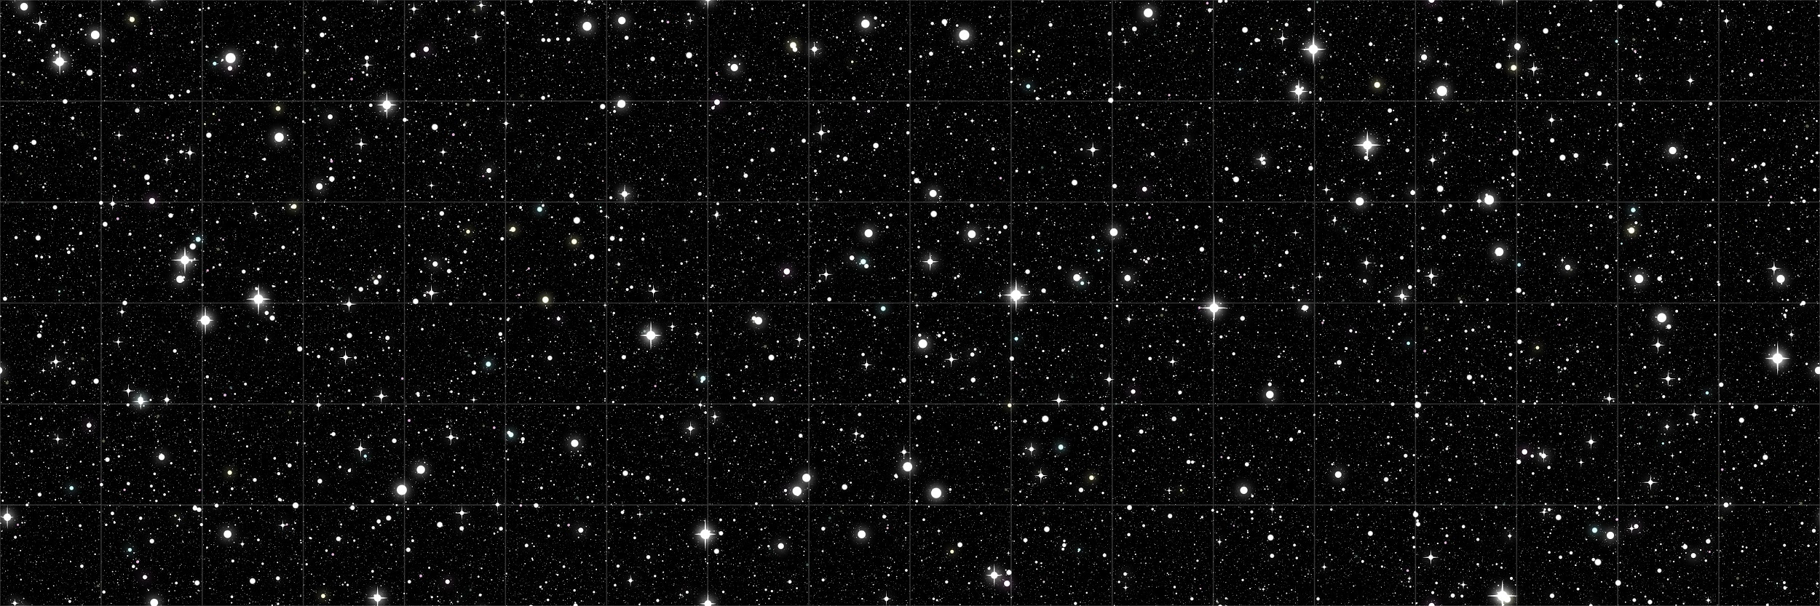
Barter System
By Diva Kunder

Slide 2
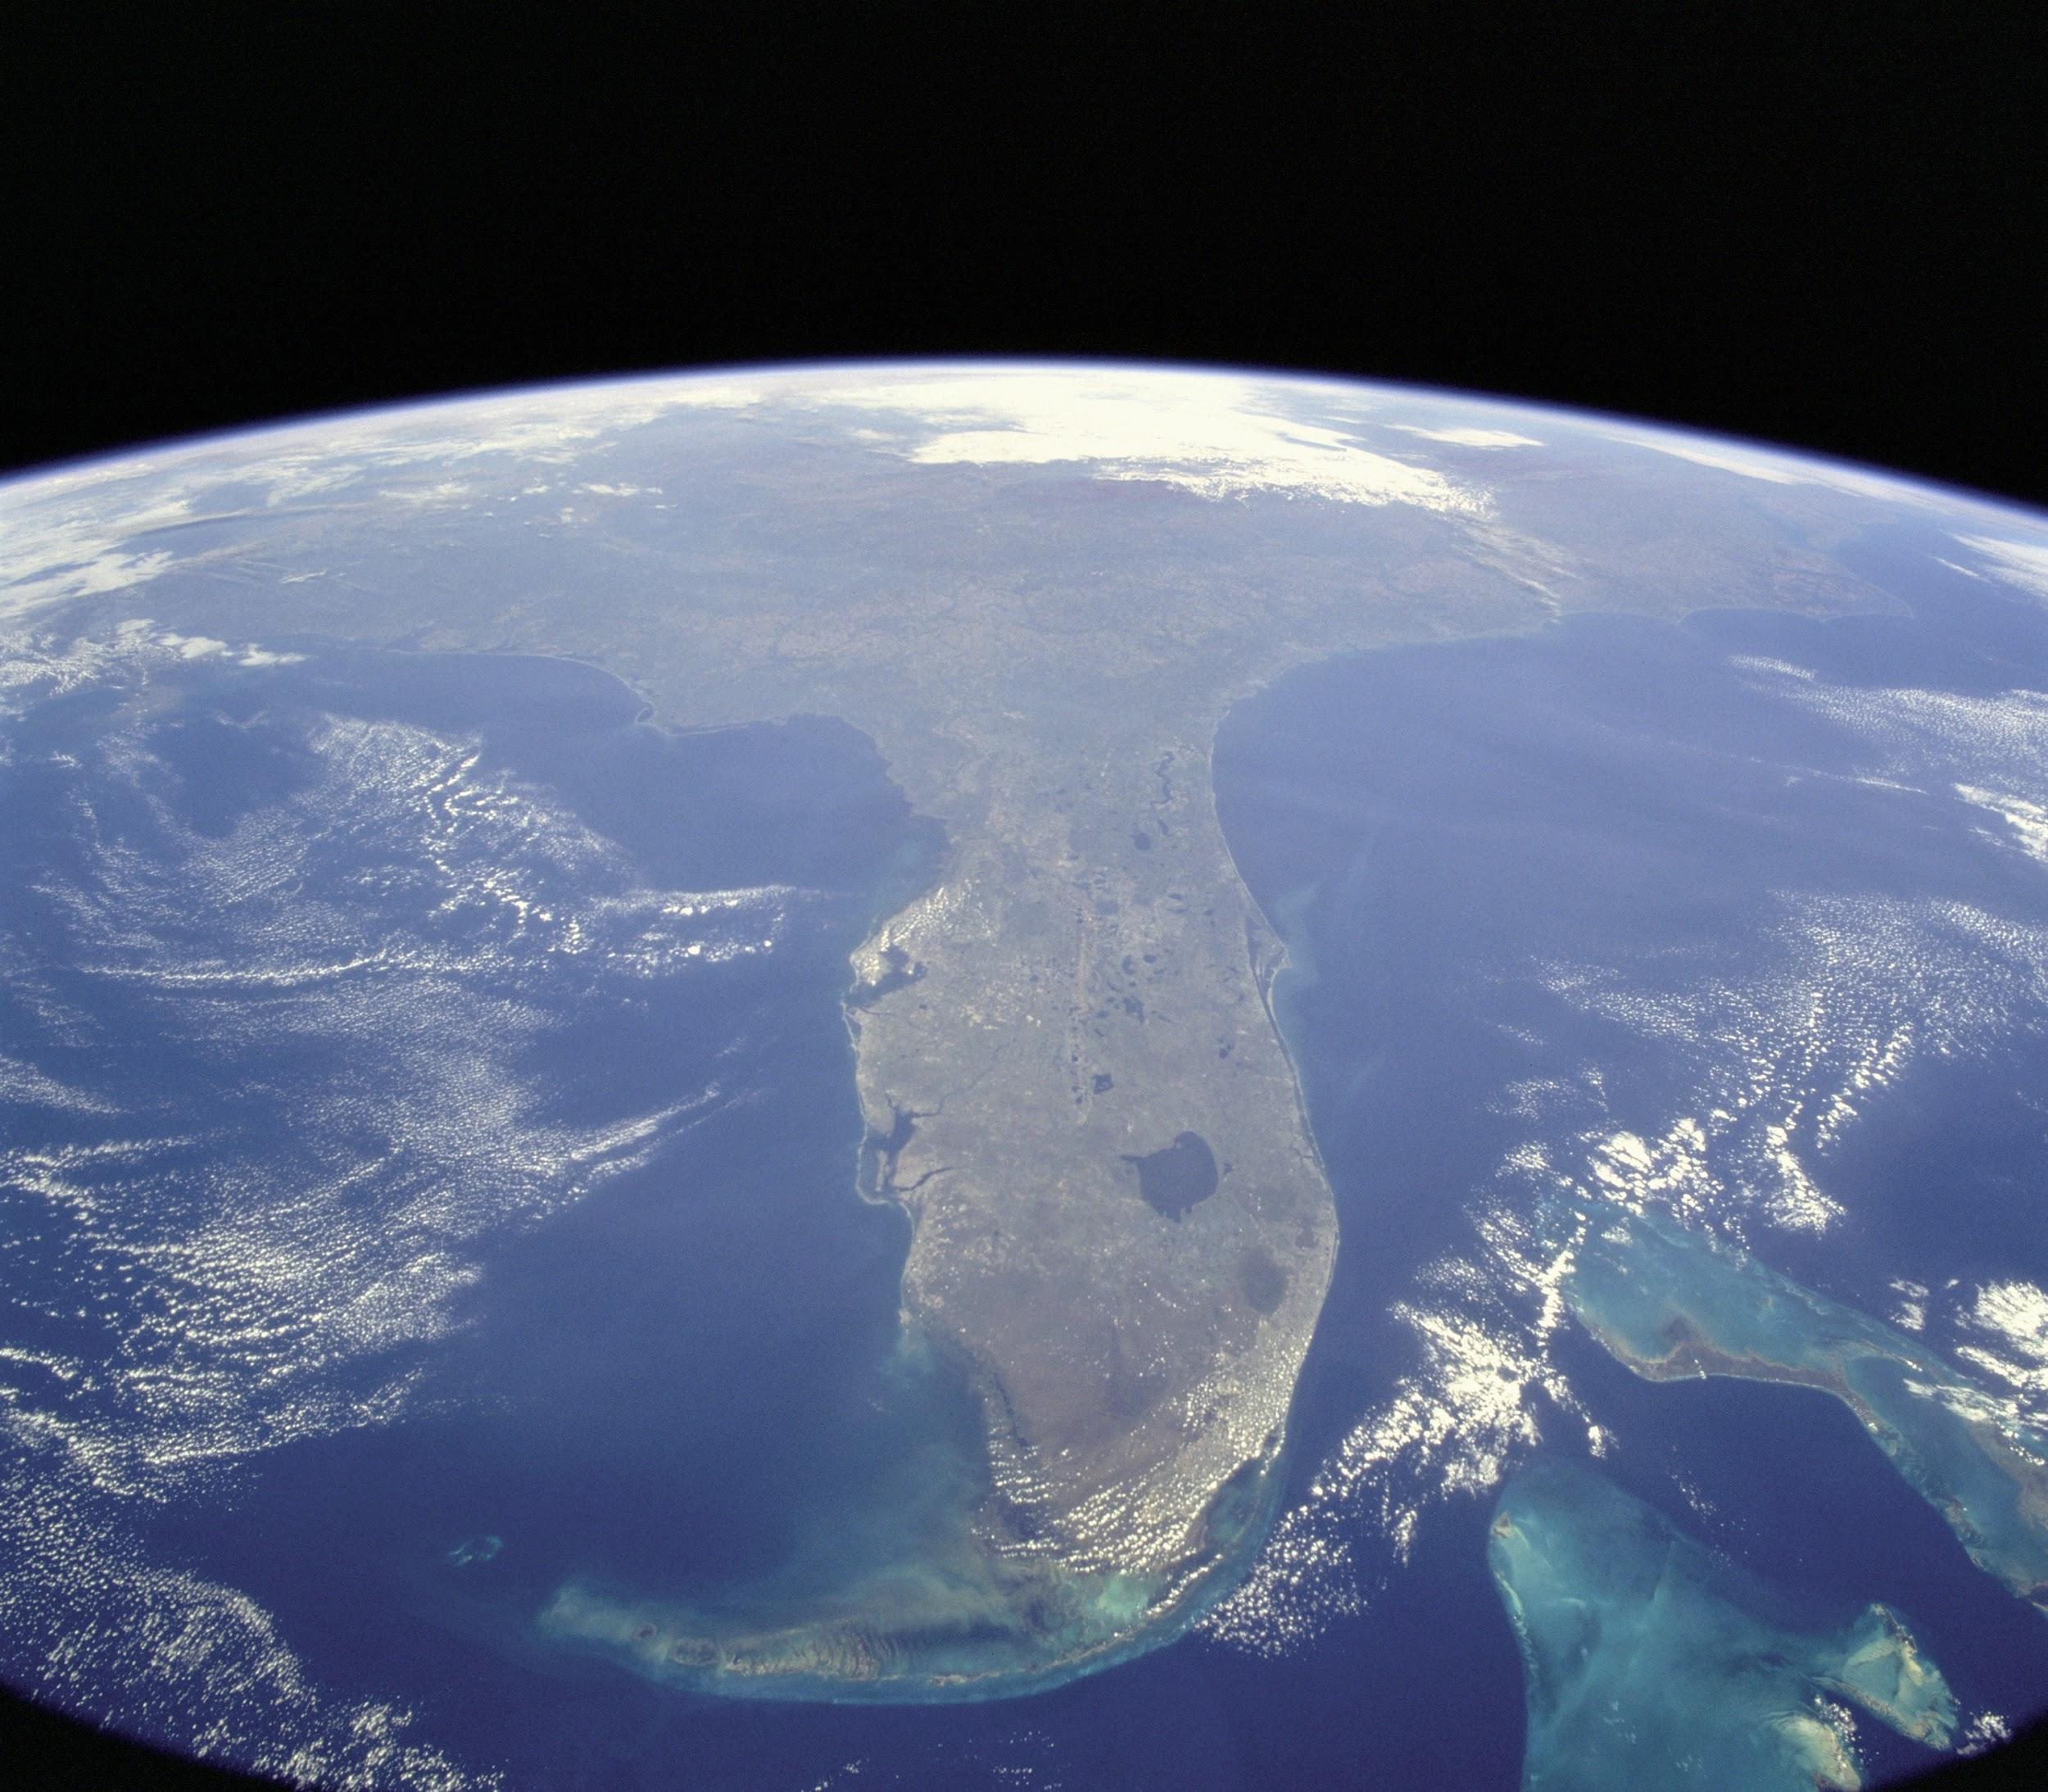
Homescreen
Barter System
ISS Location
Metroid
Updates

Slide 3
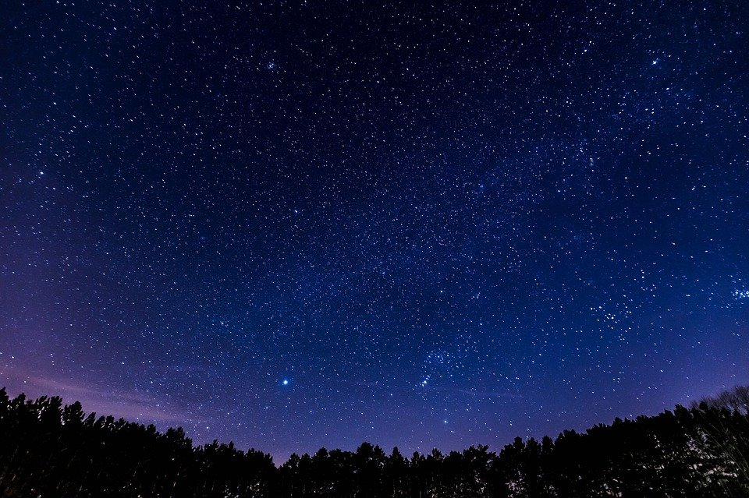
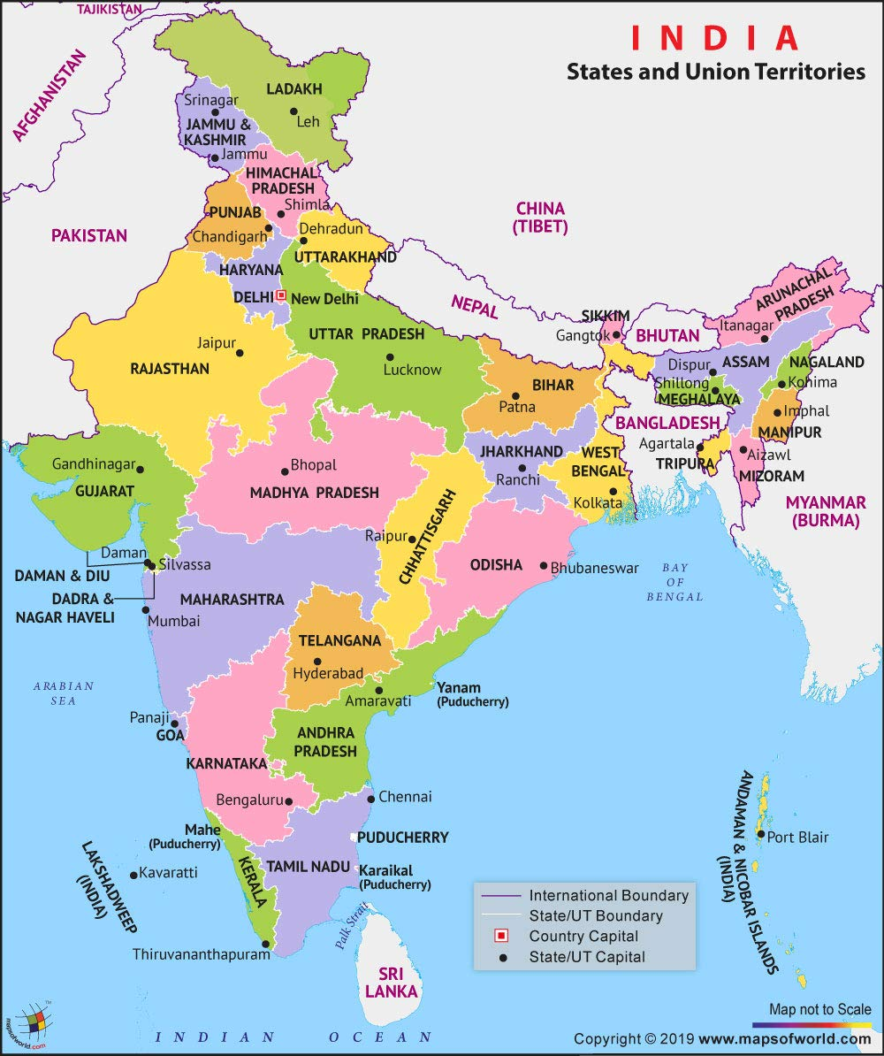
ISS Location
ISS Location
ISS Location

Slide 4
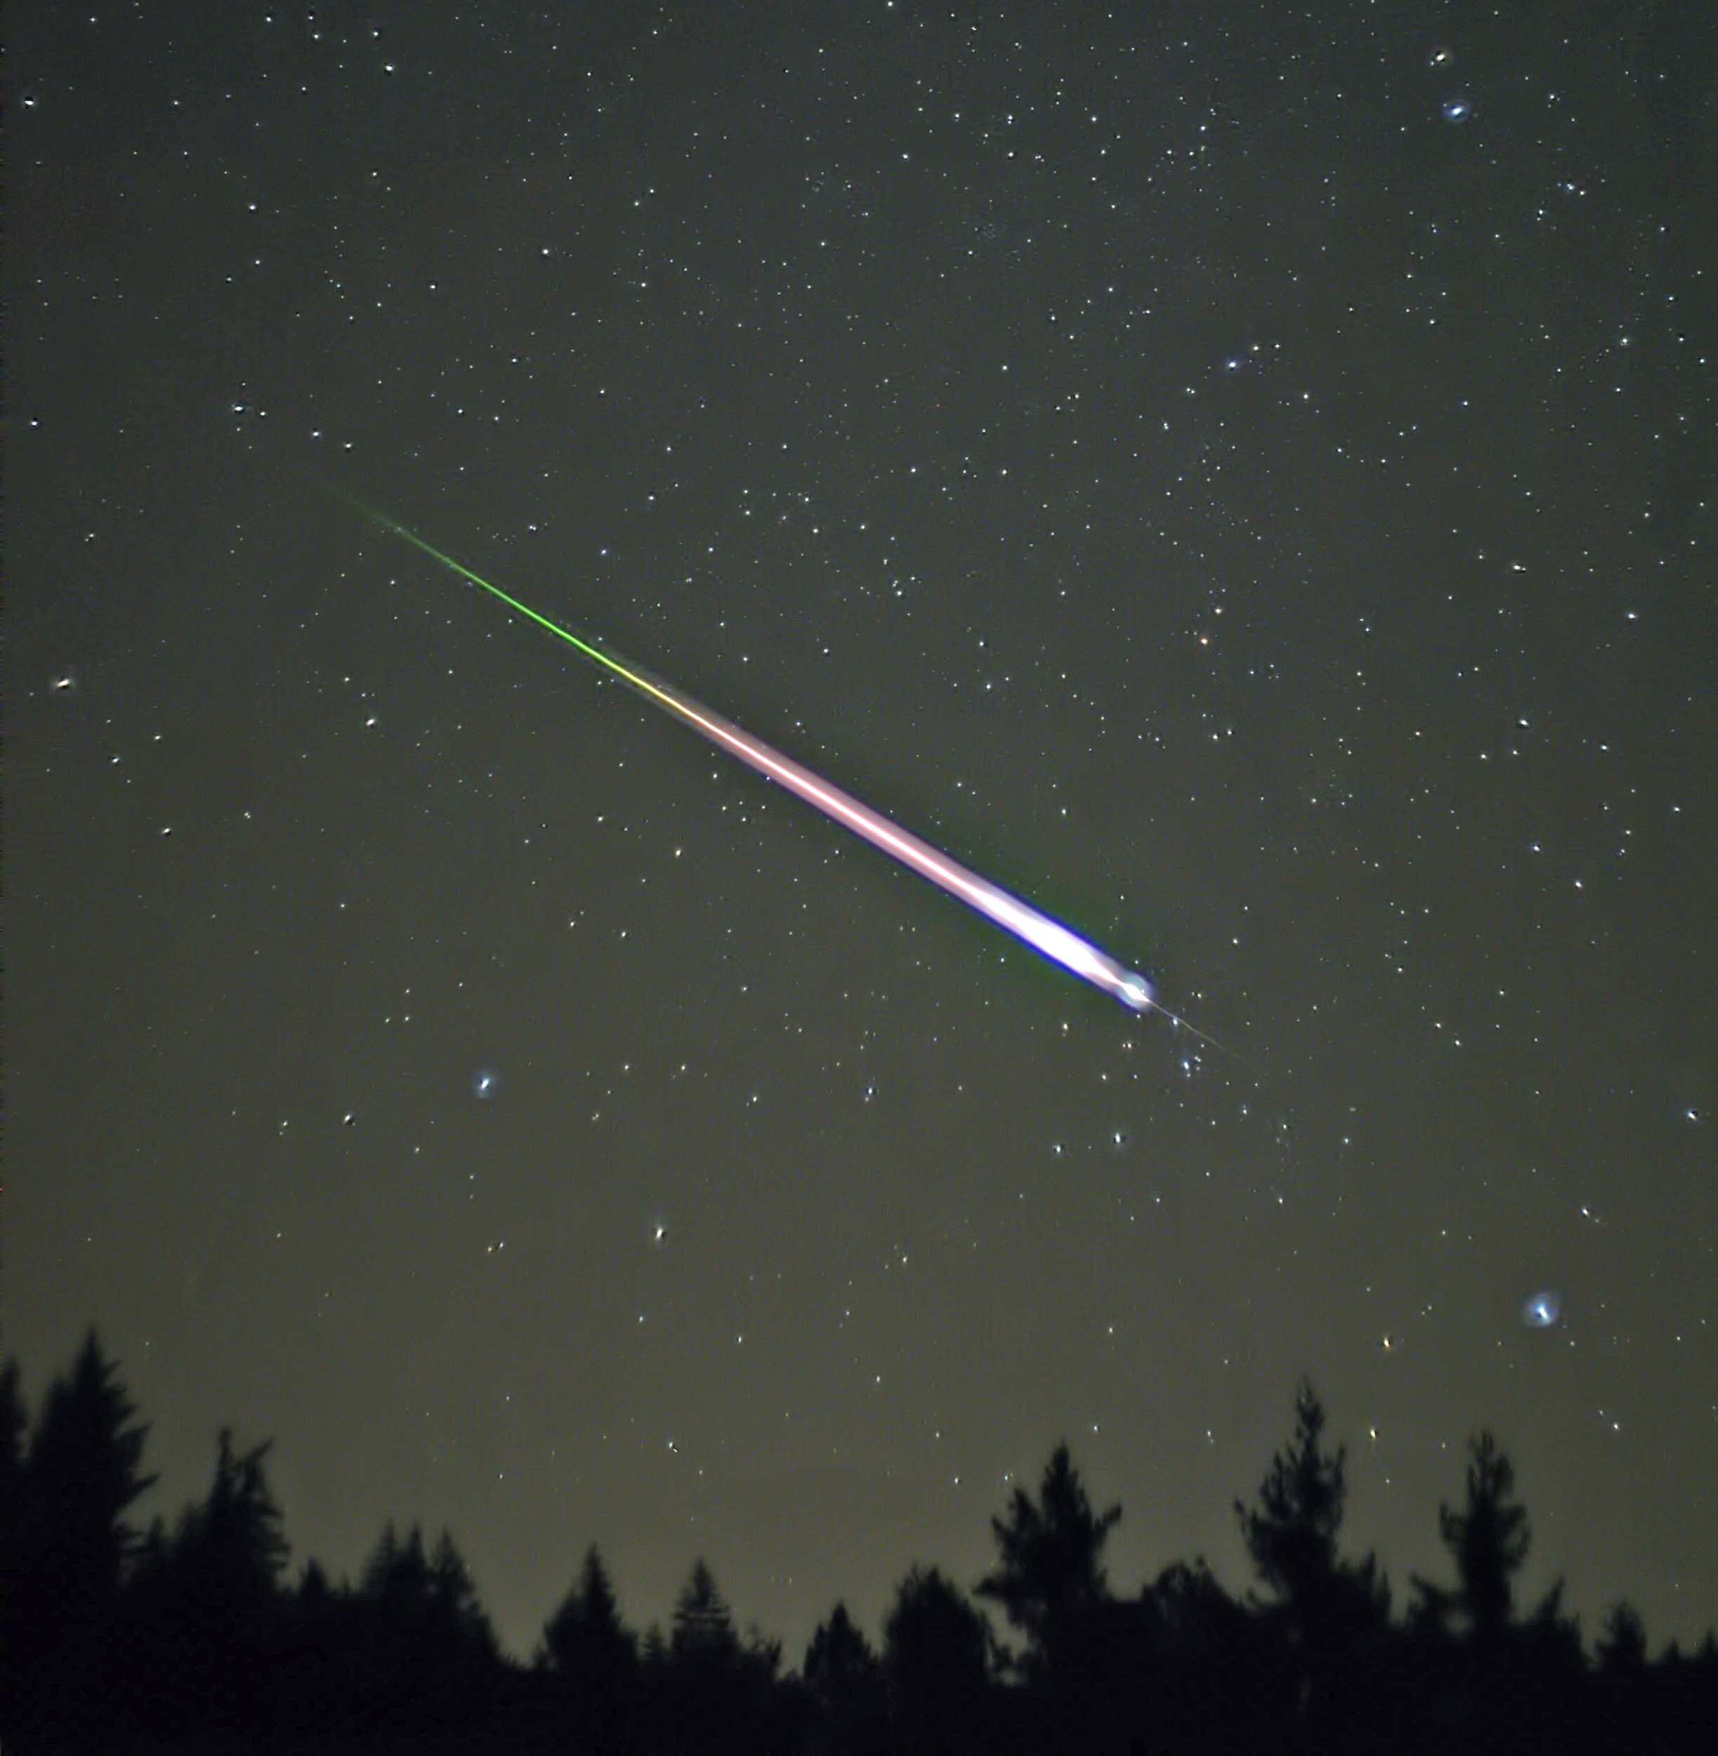
Meteor
Meteor
Information
Picture
Information
Picture

Slide 5
Updates
Updates
Updates

Slide 6
<User Stories>
For the Home screen I want to have 3 rectangular buttons labelled ISS Location, Meteor and Updates so that It is easily accessible.
For the ISS Location I want there to be a map present on that screen showing just a large view of the location so people can see it better.
For the Meteor I want there to be 2 parts, one informing the user about the meteor and one side showing the picture of the meteor.
For the Updates I want there just to be a simple list of updates.

Slide 7
Thank you!

